Slide 1
QSYS Buildings Overview (Masterplan Layout, Buildings, Rooms)
Daniel Berkowitz (MDB/ATS/ACR Unit)
Master Presentation

Slide 2
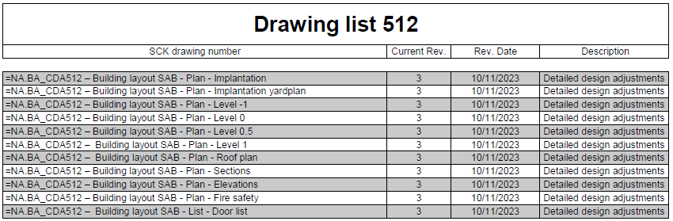
SCK CEN Auxiliary Buildings
Document Reference and Navigation
Procurement drawings: SCK CEN/85102544
Similar to permit drawings, but more accurate
Used by the contractor to construct the building

Slide 3
Mostly used for QPLANT Tender
SCK CEN Auxiliary Buildings
Document Reference and Navigation
Doc no. | Document Name | Document Description | SCK CEN Reference
1 | QSYS Masterplan Layout & Buildings | Master Presentation | SCK CEN/46467661
2 | MINERVA_4NT_862356_000_00_TOTALDOC.pdf | Realistic Building Views | SCK CEN/83474410
3 | MINERVA_4NT_862354_000_00_TOTALDOC.pdf | Masterplan | SCK CEN/84582975
4 | BA_Dienstgebouw SCK CEN_TB_N_01_T2_versie20092023_.PDF.pdf | Project Zone | SCK CEN/81504499
5 | BA_SAB 1_P_N_00_Gelijkvloers.pdf | CCB + Outside Gas Storage | SCK CEN/81503739
6 | BA_SAB 1_P_N_02_Dakplan.pdf | CCB roof | SCK CEN/81505370
7 | BA_SAB 1_S_N_AA_Snede AA_.pdf | CCB section | SCK CEN/81505150
8 | BA_SAB 1_S_N_BB_Snede BB_.pdf | CCB section | SCK CEN/81506075
9 | BA_SAB 1_G_N_GO_Gevelzicht Oost.pdf | CCB side view | SCK CEN/81506386
10 | BA_SAB 2_G_N_GW_Gevelzicht West.pdf | AUB side view | SCK CEN/81505064
11 | BA_SAB 1_P_N_00_Gelijkvloers.pdf | AUB | SCK CEN/81503739
12 | BA_SAB 2_S_N_CC_Snede CC_.pdf | AUB section | SCK CEN/81504370
13 | BA_SAB 1_S_N_BB_Snede BB_.pdf | AUB section | SCK CEN/81506075
14 | BA_SAB 2_P_N_02_Dakplan.pdf | AUB roof | SCK CEN/81504187
15 | BA_SAB 2_G_N_GN_Gevelzicht Noord.pdf | AUB side view | SCK CEN/81504188
16 | BA_SAB 2_G_N_GZ_Gevelzicht Zuid.pdf | AUB side view | SCK CEN/81506074

Slide 4
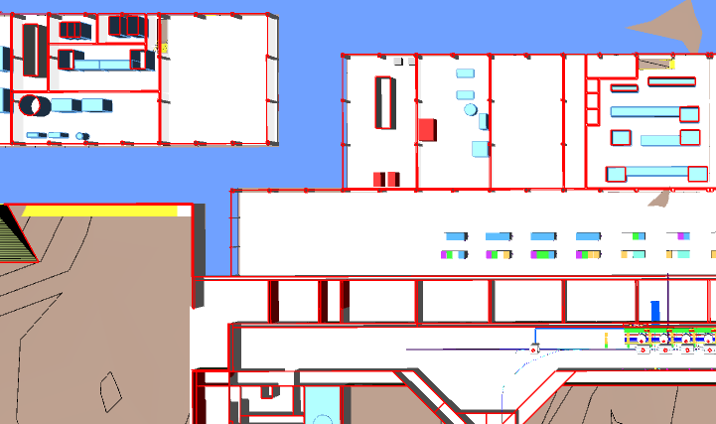
CCB
AUB.xxx
Cryoplant & Infrastructure
WCS
QRB
WSH
WSH
WSH
LTU
Cryo Backbone (QDB)
QLM
WPS
QVB
QVB
QVE
Cryomodules
QM
QM
QCELL

Slide 5
1. Buildings Masterplan

Slide 6
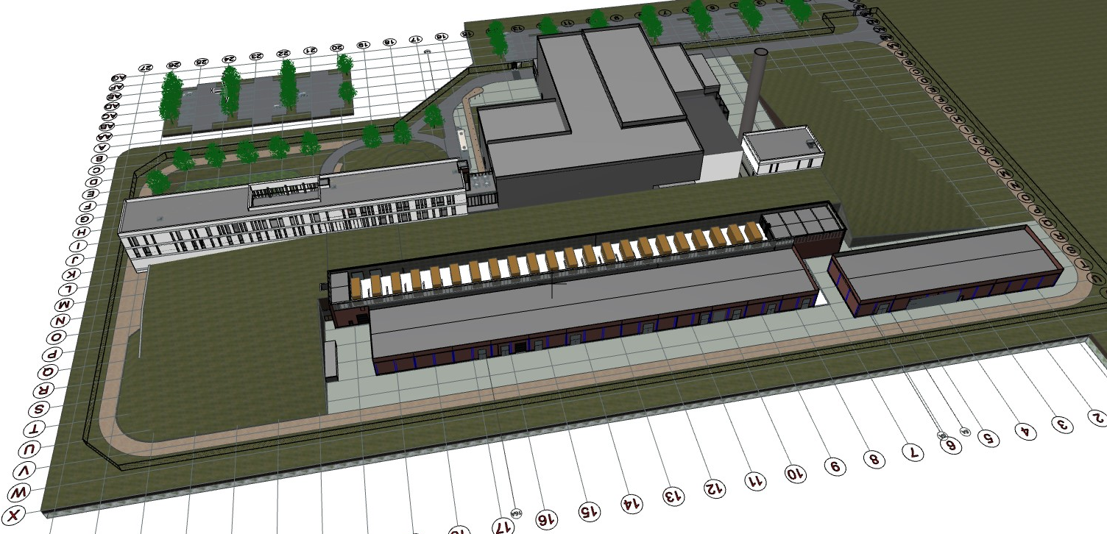

3D model
SC LINAC
Injector
RF Gallery
CCB Building
AUB Building

Slide 7
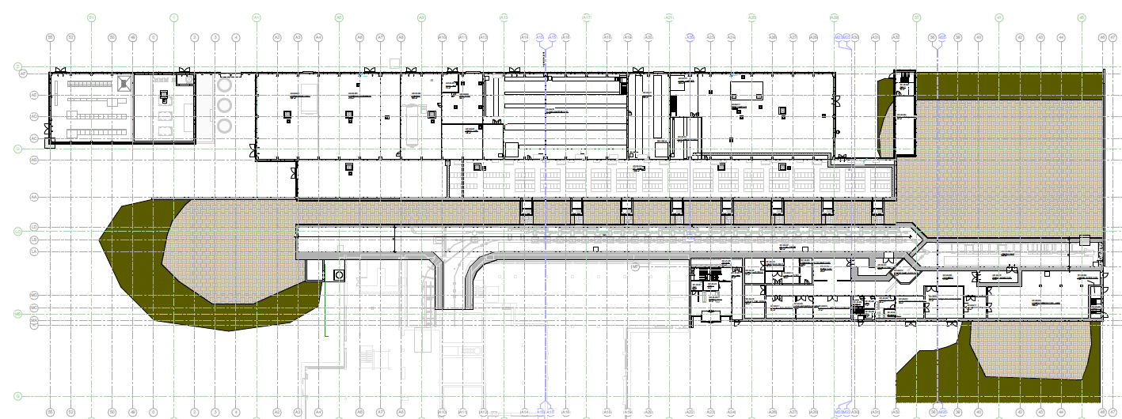
Buildings Masterplan
=NA.BA_CDA514-Building layout NF ACC - Plan-level 0
CCB Building
AUB Building
RF Gallery
LTU

Slide 8
QSYS Buildings

Slide 9
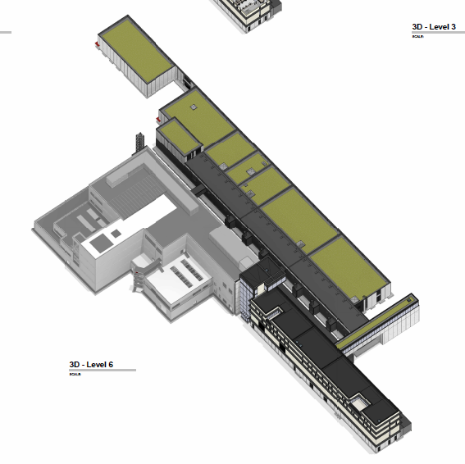
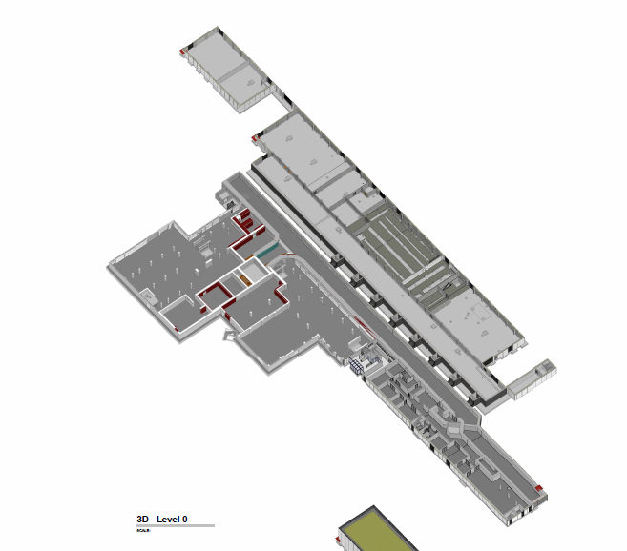
QSYS Buildings
SCK CEN/83474410
Buildings - Level 0
MYRRHA
Reactor
Warm Compressor Station (WCS)
Warm Gas Storage (WSG)
Main Cryolyne (QLM)
Refrigerator Coldbox (QRB)
Phase 1
Cryocells (QCELL)
End Box (QVE)

Slide 10
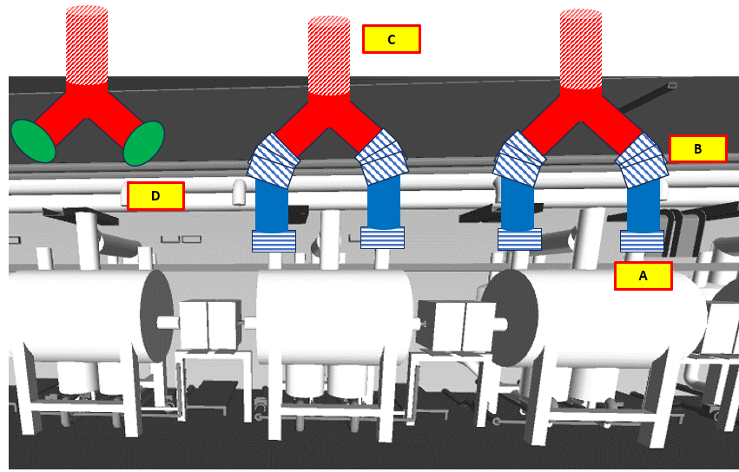
QSYS Buildings (QB_x)
SCK CEN/83474410
Buildings - Level 0
QSYS is spread across SAB1, SAB2, and LTU
QSYS has high stakes when main equipment is installed, and low stakes when it is used for routing or peripherals
High Stakes:
Main Equipment installed on premise
6
# | Building | QSYS top-level (*main) | QSYS Equipment
QB_1 | LTU/interior | QCELL* QDIST QINFRA | QM QVB QVE QLM WPS
QB_2 | LTU/Chicane | QDIST* QINFRA | QLM WPS
QB_3 | SAB2/RF-Gallery | QDIST* QINFRA | QLM WPS
QB_4 | SAB2/QRB Room | QPLANT QDIST QINFRA | QRB WPS QLM
QB_5 | SAB2/Other | QPLANT QINFRA? | WCS WPS?
QB_6 | SAB1/CCB | QPLANT QINFRA | WCS WSH
QB_7 | LTU/vents | QINFRA | WPS
QB_8 | SAB2/RF-Gallery | QCELL QDIST QINFRA | QC_int
Low Stakes:
Only peripherals or routing pipes
3
5
2
4
1
8
7

Slide 11
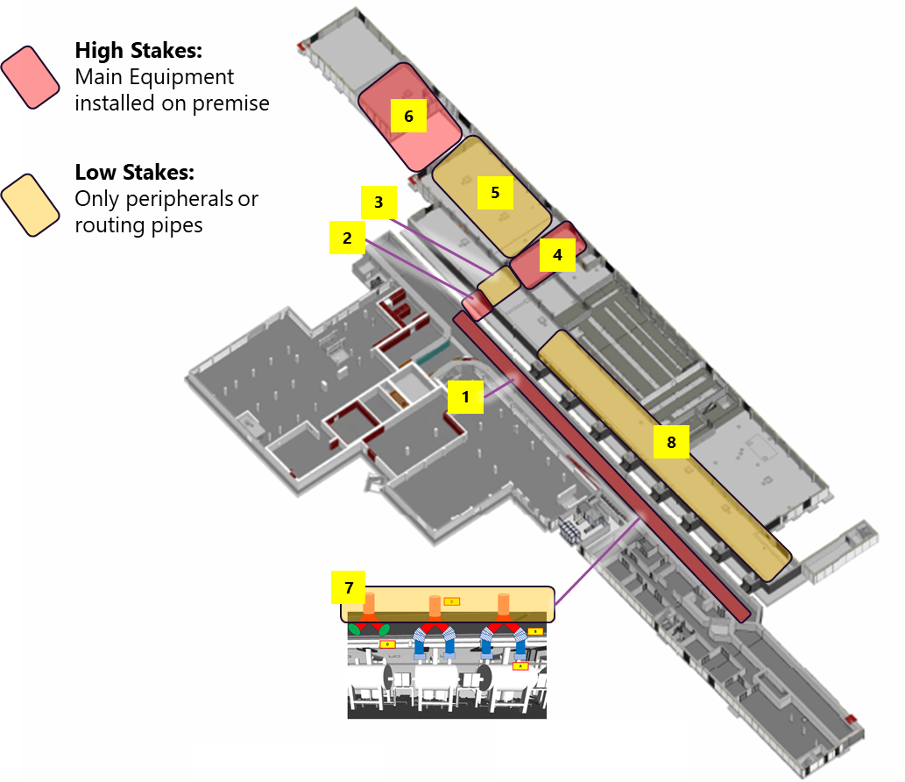
QSYS Buildings
7
=NA.BA_CDA514-Building layout NF ACC - Plan-level 0
6
5
4
3
8
2
1

Slide 12
QDB Segmentation (colloquial term)
From ALX/46467661
QRB Room
2.3
2.2
AUB Hallway
2.1
Chicane Room
1.4
1.3
QDB Segment 1.2
1.1
TS-S01 to S03
LB-S25 to S30
Corresponds to location LB-S01 to S24
SB-LB01
QDB Segmentation
The QDB has 2 main segments (LTU and non-LTU), with 4 and 3 subsegments respectively.
The VLP-flow direction is the reference direction for all orientation and segmentation conventions.
When producing cross-sections or views, the observer is always “looking in the VLP-flow direction” (i.e., the VLP-flow goes into the screen).
Spools
Each spool is defined by two flanges: Flange A and Flange B
Flange A is the upstream flange (i.e., first in the VLP-flow direction), and Flange B is downstream
A QLM spool belongs to the section where its Flange A is located.

Slide 13
QDB Sectorization
Section 7
Section 6
Section 5
Section 4
Section 3
Section 2
Section 1
QDB Sectorization
Section names follow the convention: Section 1, Section 2, Section 3, etc.
The VLP-flow direction is the reference direction for all orientation and sectioning conventions.
When producing cross-sections or views, the observer is always “looking in the VLP-flow direction” (i.e., the VLP-flow goes into the screen).
Spools
Each spool is defined by two flanges: Flange A and Flange B
Flange A is the upstream flange (i.e., first in the VLP-flow direction), and Flange B is downstream
A QLM spool belongs to the section where its Flange A is located.

Slide 14
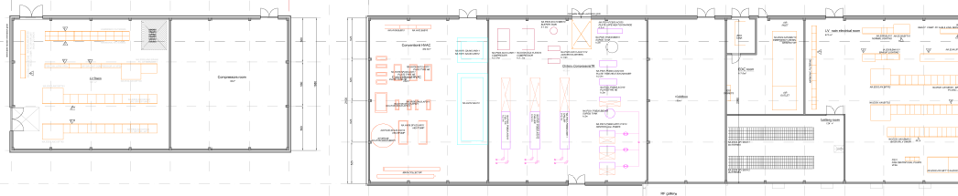
QSYS Buildings
Fixed Building dimensions!
WCS
WSH
QRB
FYI,
=NA.BA_CDA514 – Building layout NF ACC - Plan - Level 0.pdf https://ecm.sckcen.be/OTCS/llisapi.dll/link/81841578

Slide 15

WPS Lines (Warm Piping System)
On purpose, we do not show here the connections of the main He process to S or V
V_{QCELL#24}
V_{QCELLx}
LTU Shielding
From QLM INVAC x2
To HP of WCS inlet
W
V
To HP of WCS inlet (+ reheater)
S
From QCELL #1
V_{QVE}
From QM INVAC
From QM INVAC
QRB
A
B
D
E
QLM
Cold Box Room
QCELL # 24
LTU
QVE
Chicane
RF Gallery
Or #12 ?
QCELL # xx

Slide 16
QB_1 – LTU/interior
QB_7 Scope
LTU roof
QB_1 Scope
LTU interior
W
S
U
SAB2/AUB
LTU chicane
QLM
QLM
QVB24
QVBj
QVB01
QVE
QB_3 Scope
QM24
QMj
QM01
QB_2 Scope
QCELL 30-25
QCELL 24 to 01
QVE

Slide 17
QB_2 – LTU/chicane
QB_2 Scope
LTU interior
W
S
U
SAB2/AUB
LTU chicane
QLM
QB_3 Scope
QB_1 Scope

Slide 18
Overview of QSYS Headers
SCK CEN/81503739
Quantity TBC
V
V
V
31x lines (TBC)
QRB Room
RF Gallery
Chicane
LTU
S
W
U
QLM
A
B
D
E

Slide 19
Building Architecture Requirements
Fixed dimensions of CCB (WCS) and AUB (Coldbox Room)
Coldbox move-in via roof – BA coordination during installation
Routing of internal (scope of piping (AUB to CCB))
Penetrations and ‘routing path’ for QPLANT Contractor
Avoid ACC NF equipment and allow welding (15cm clearance for orbital welding)
Avoidance of oil spill and release to environment – CCB confinement
Additional noise mitigation – BA responsibility
Routing of QLR (from LTU to QRB)
Routing of additional warm piping
Same as main cryogenic distribution (LTU to QRB)

Slide 20
2b. Buildings for QDB

Slide 21
2c. LTU (QSYS specific)

Slide 22
3a. CCB Building (for WCS)

Slide 23
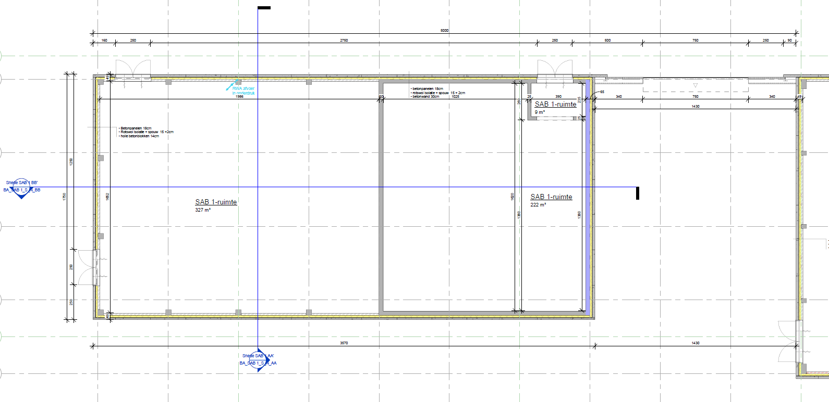
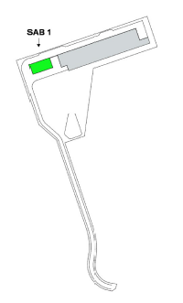
CCB - Dimensions
SCK CEN/81503739
Building design ready for start of detailed-design-for-procurement
Dedicated electrical equipment for WCS (scope NFS)
Room for WCS Components (scope QSYS/QPLANT)
Space for WSH (scope QSYS/QINFRA)

Slide 24
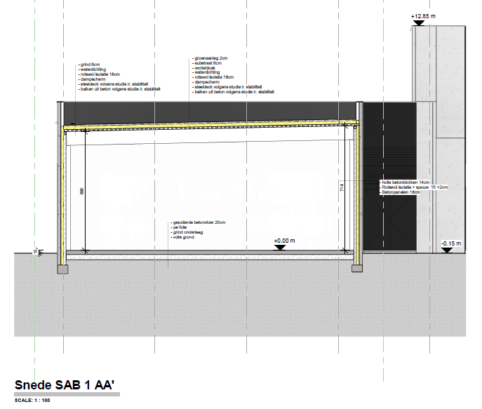
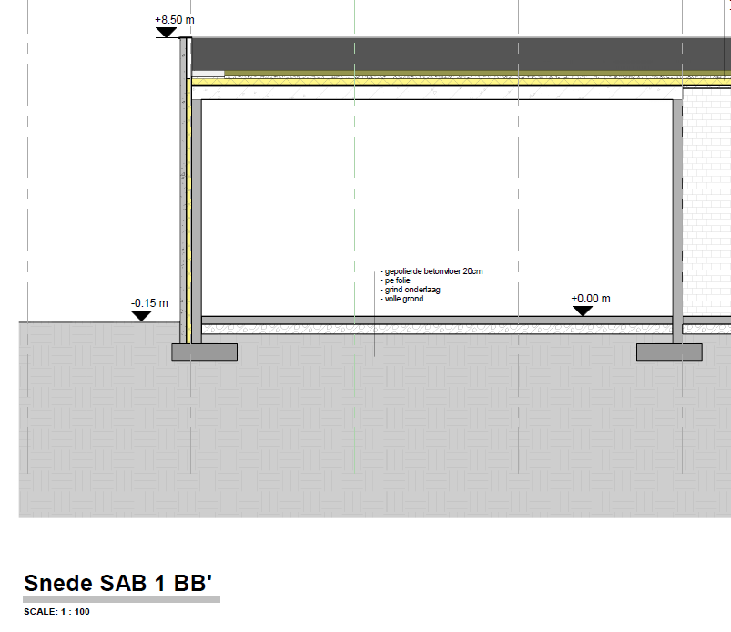
CCB – Cross-sections
BB’
SCK CEN/81503739
AA’
WCS
Dedicated Electrical Room for WCS

Slide 25
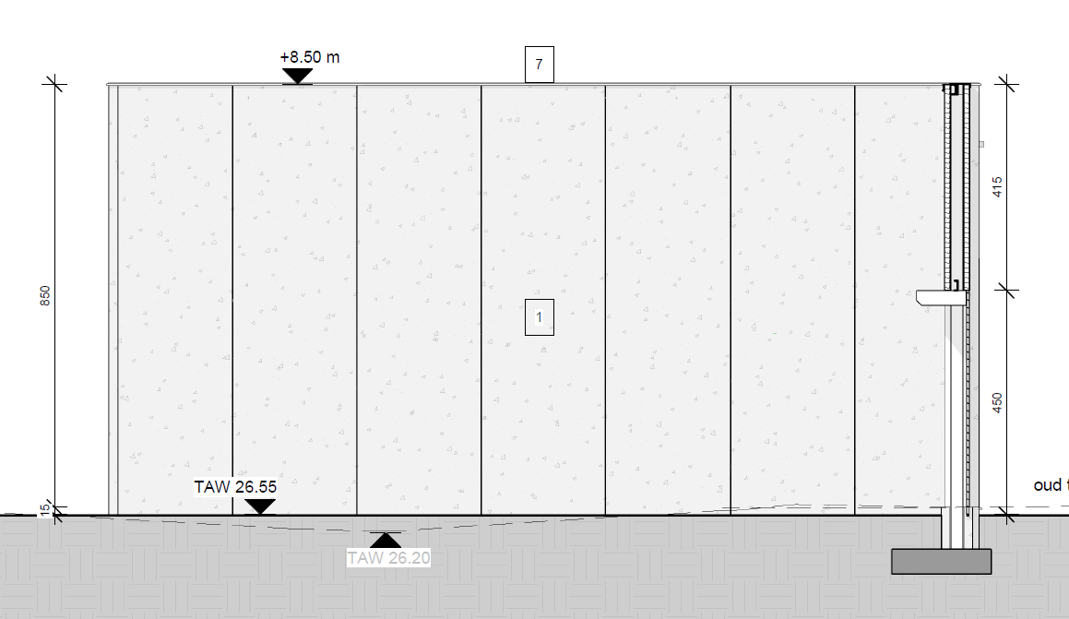
CCB – Cross-sections
SCK CEN/81506386
Side View – East (towards WCS)
Area for Warm Piping Penetration – above 4.5 m access door. Specific location TBD

Slide 26
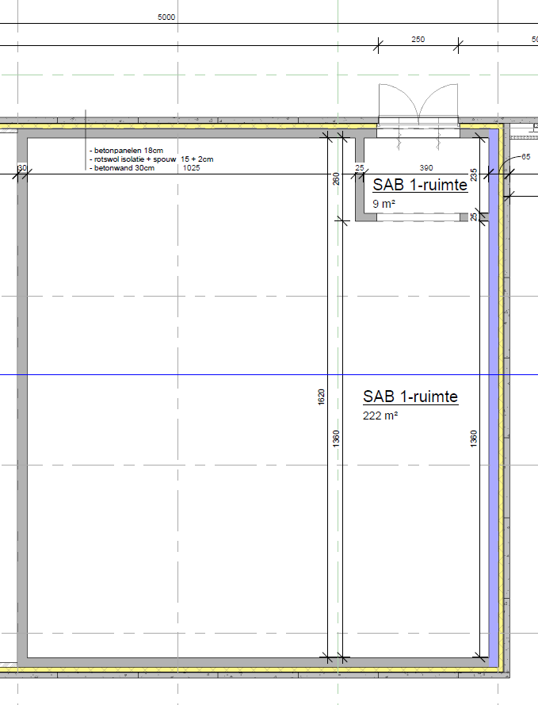
CCB – Room details
Door Access for biggest equipment – HP compressor Skids
Noise Abatement (75 dB loudest equipment)
Design to prevent oil (oil lubricated compressors) contamination to outside
Individual drip pans for HP and PVPS TBD
Room for WCS Components (scope QSYS/QPLANT)

Slide 27
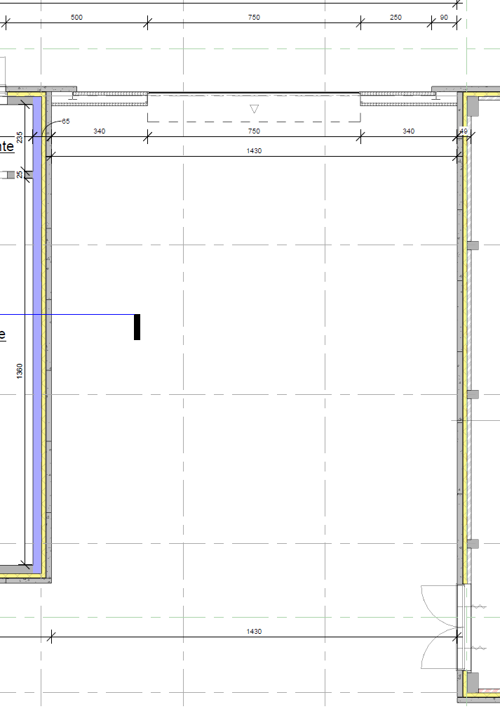
CCB – Exterior Details
Space for 3x120 m³ Helium storage vessels (WGS)
Space for 1x30 ton Liquid Nitrogen and Evaporator (Not ACC NF scope
Access for truck inside and/or via wall connections
Space for WSH (scope QSYS/QINFRA)

Slide 28
3b. AUB Rooms (for QRB)

Slide 29
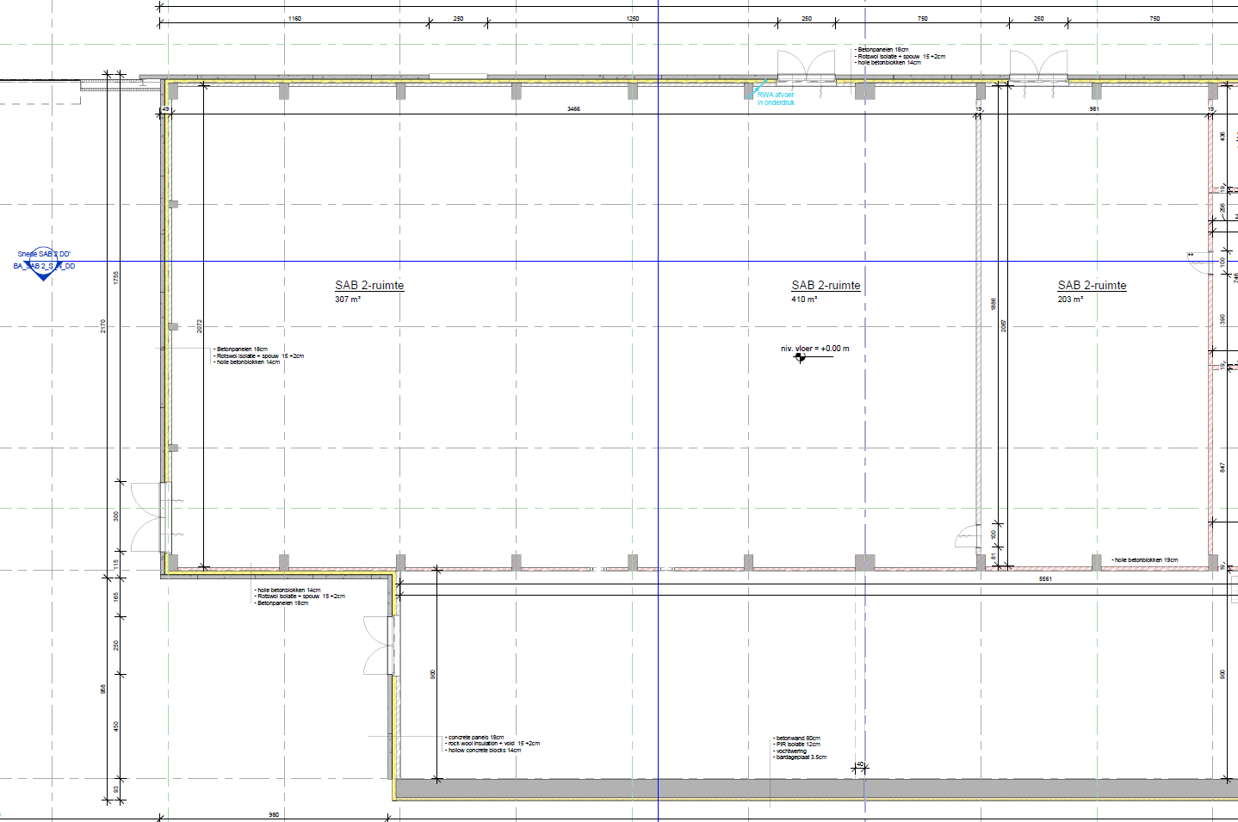
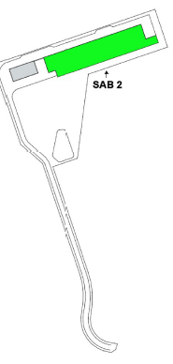
AUB for QRB
SCK CEN/81503739
Room for QRB Components (scope QSYS/QPLANT)

Slide 30
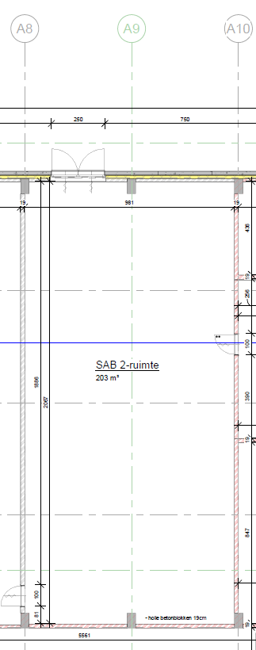
AUB for QRB - Room Dimensions
SCK CEN/81503739
Space for Horisontal Coldbox
Need to avoid structural beams ~5 m apart
Possible routing of warm piping via roof
Preferred horizontal penetration
Access Door to small (2.5 m) for QRB move-in
Removal of single panel (~5m vertical considered)
Preferred option is rooftop access
Room for QRB Components (scope QSYS/QPLANT)

Slide 31
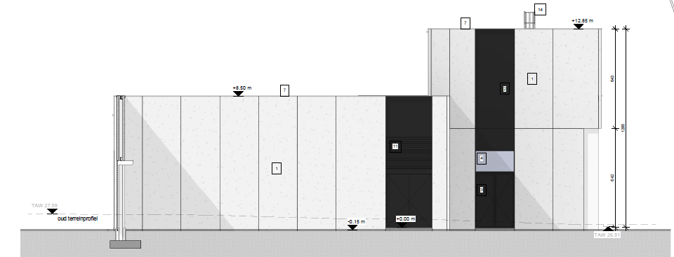
AUB for QRB -
SCK CEN/81505064
AUB Side View – West (towards QRB)
Area for Warm Piping Penetration – above 4.5 m access door. Specific location TBD

Slide 32
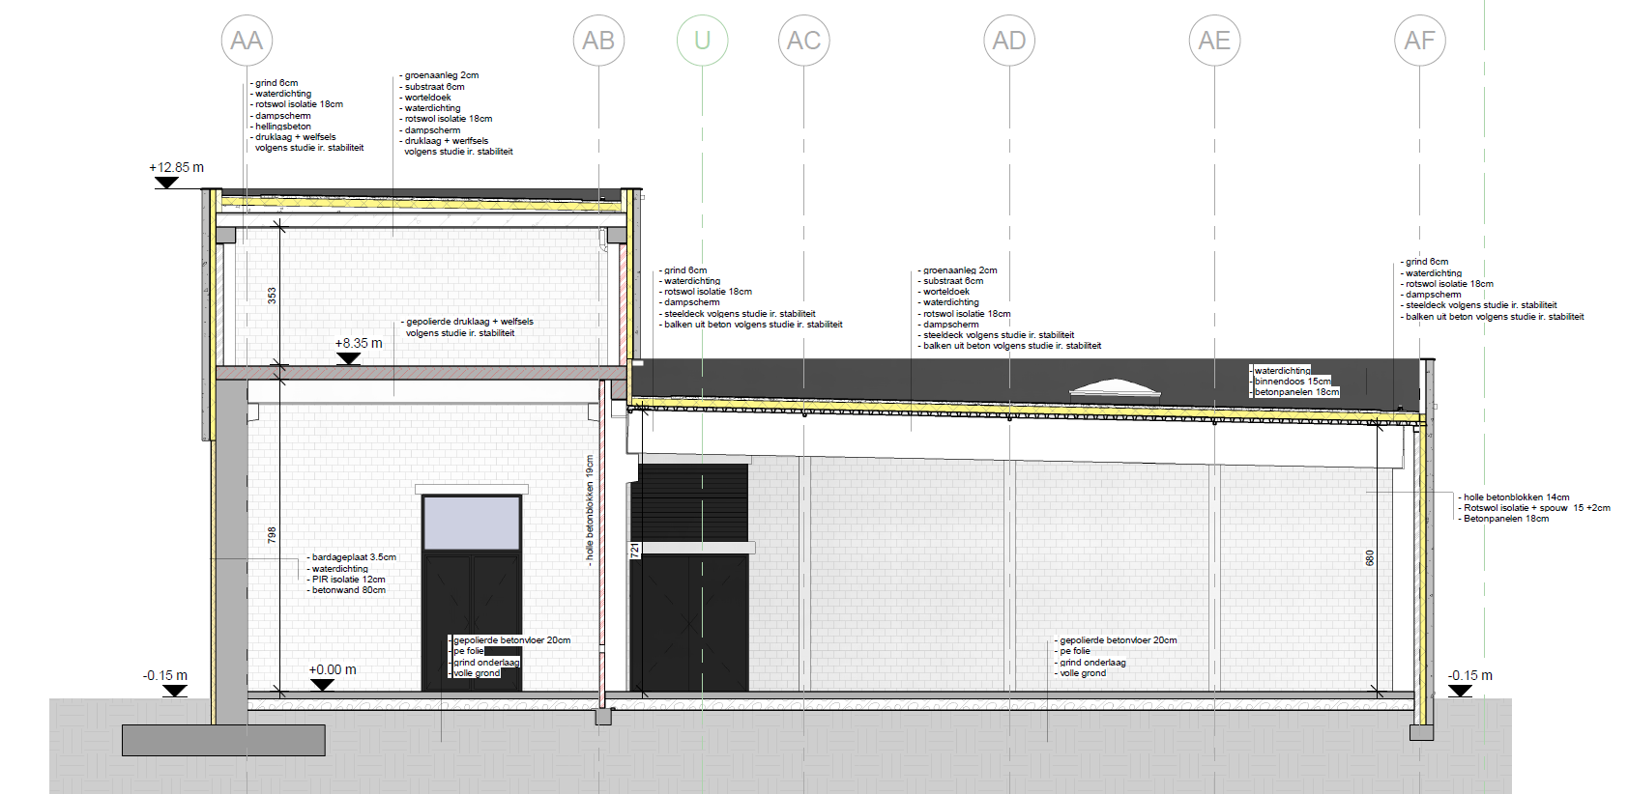

Nuclear Facilities (ACC NF)
SCK CEN/81504370
AUB Cros-section
Note Sloping Roof
Structural Support Roof (~5m apart)
QRB place between to maximize height

Slide 33
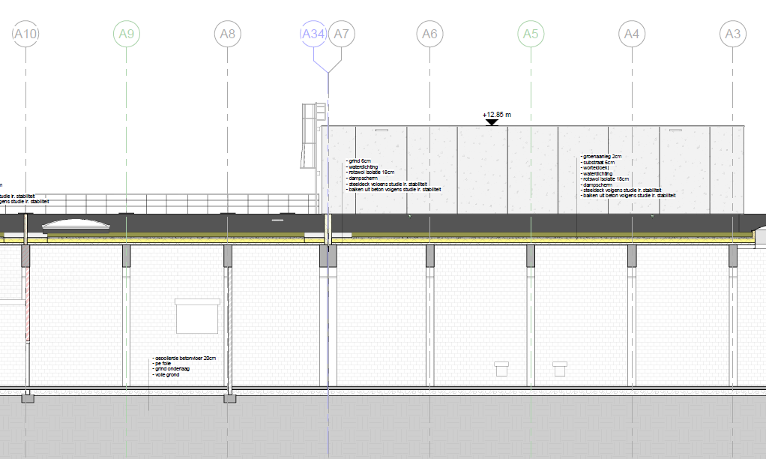

ColdBox Room
SCK CEN/81506075
AUB Cros-Section
Structural Support Roof (~5m apart)
Coldbox Room

Slide 34
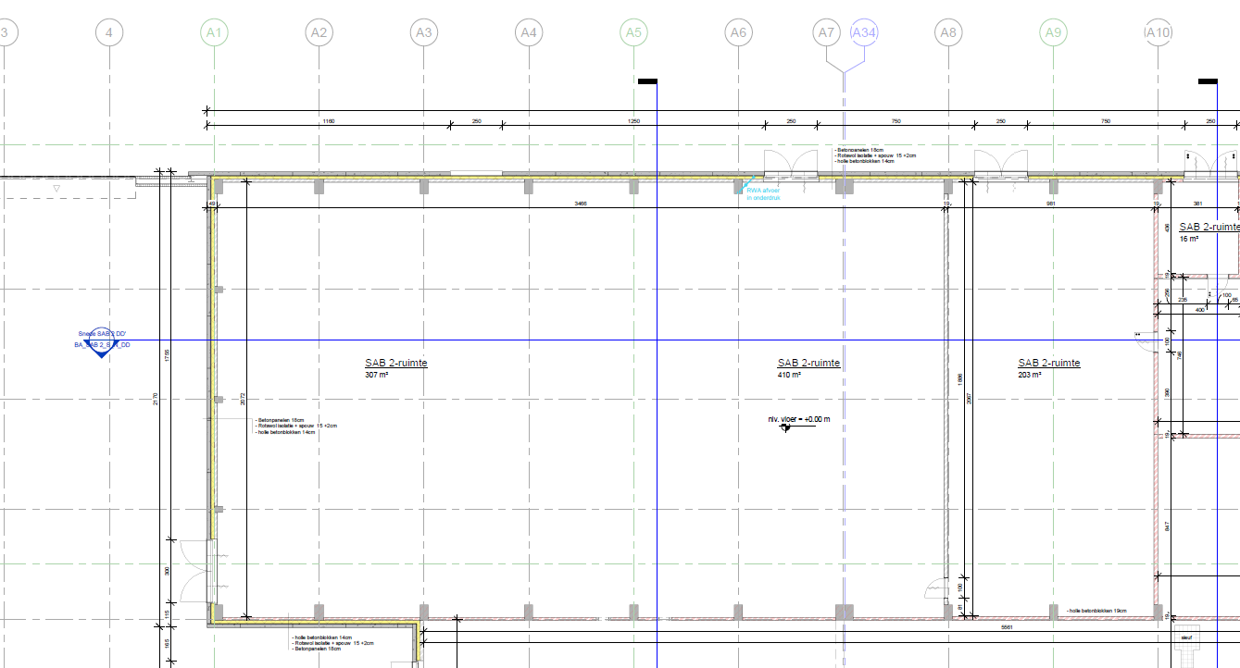
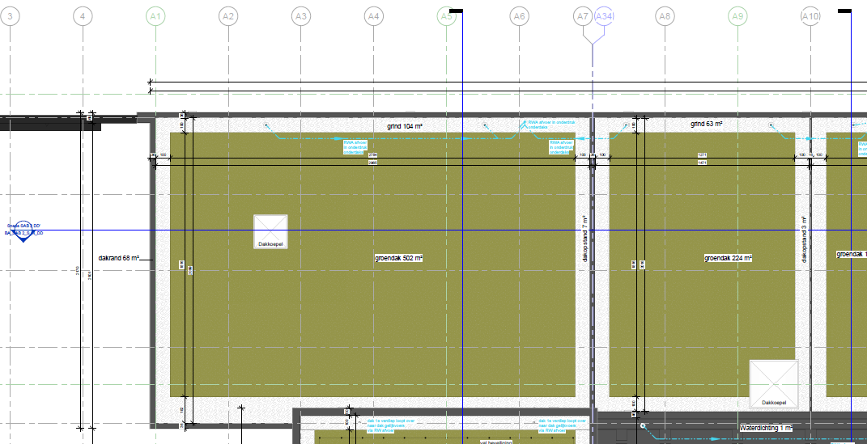
Separate Cryogenic Compressor Building
SCK CEN/81504187
Cold Box room in AUB
Ground Floor – Coldbox
Roof - Coldbox

Slide 35
WARM PIPE ROUTING
Cold Box room in AUB towards CCB
Through AUB routing (2 wall penetrations)
Via Roof (vertical penetration)
– more bends, avoid ACC NF SSC

Slide 36
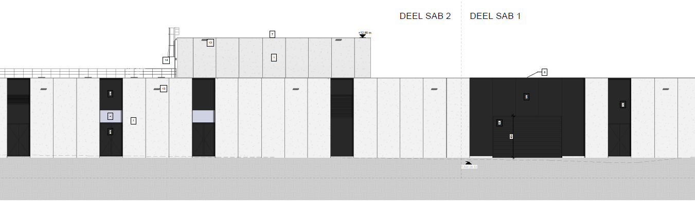
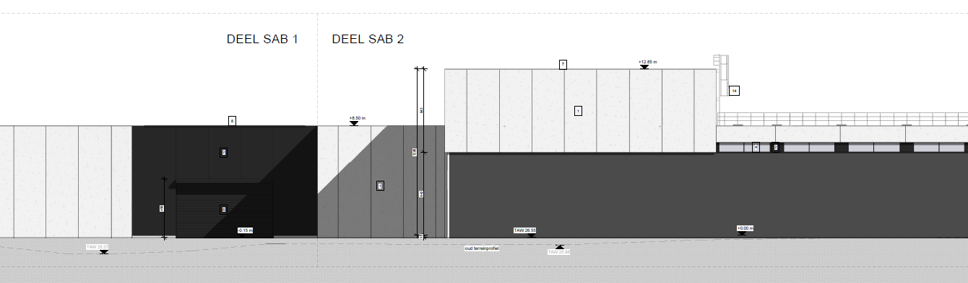
AUB for QRB – side views
SCK CEN/81504188
SCK CEN/81506074
North View
Equipment – Move from South Side
Cold Box Room
South View
From LTU via RF Gallery
Cold Box Room

Slide 37
4a. QRB Move In

Slide 38
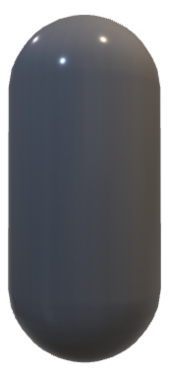

Cold Box - Dimensions
SCK CEN/81790617
Cold Box is largest item of QRB
L = 11m
D = 3.5-4m

Slide 39
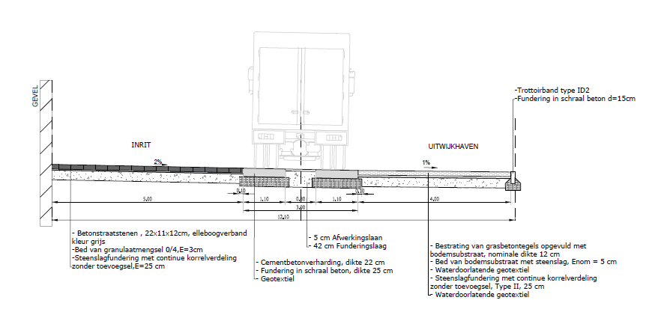
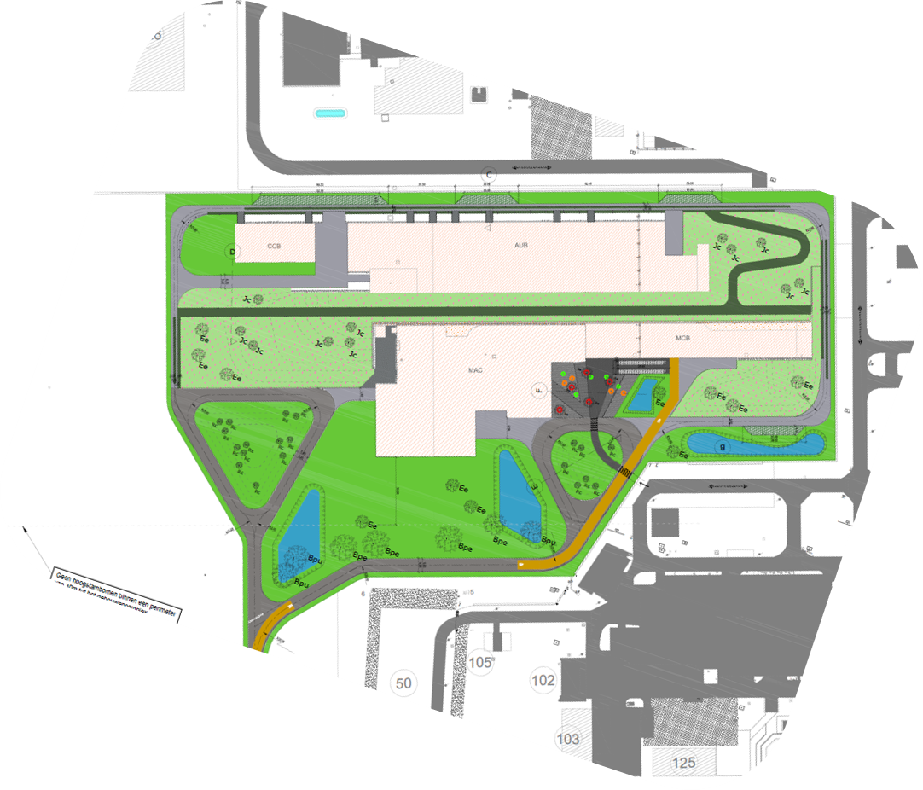


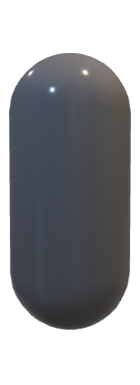


Cold Box - Transporting
SCK CEN/81790617
QRB
QRB
Transport Positioning
L = 11m
D=3.5-4m
12 m available
QRB Move-in
Flatbed + Crane

Slide 40
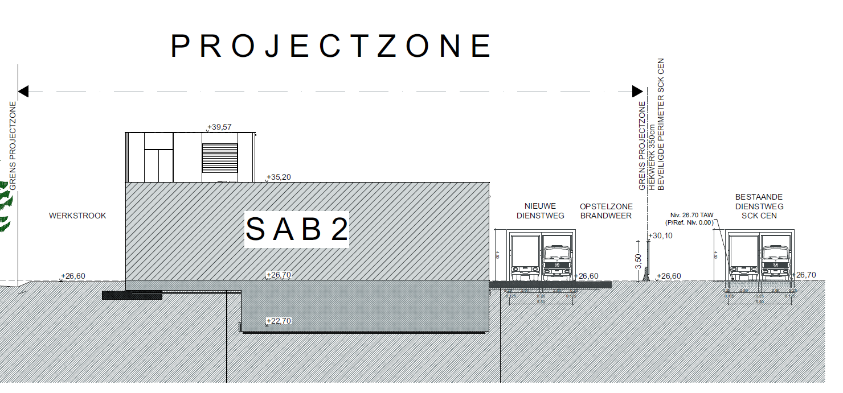
SCK CEN/81504499
Equipment – Move from South Side

Slide 41


Cold Box – Move into Building
SCK CEN/81504499
Two possible options: 3A or 3B
Note that 3B needs a crane
1) Unload from flatbed
2) Rotate
3 option A) Move Sideways
3 option B) Move through roof
NEEDS CRANE

Slide 42
Masterplan Requirements (ACC NF)
Space between SAB and MINERVA (south) perimeter fencing for unloading and move-in (QRB specific)
Access for/to crane for lifting of QRB
Present preference via Roof Access
Weight <= 100 ton (expected ~70 ton)
Access for/to crane for lifting of WGS
3 x 120 m³ gas storage vessels
Handling of instantaneous load on ground (QRB specific) – Road/Flat surfaces

Slide 43
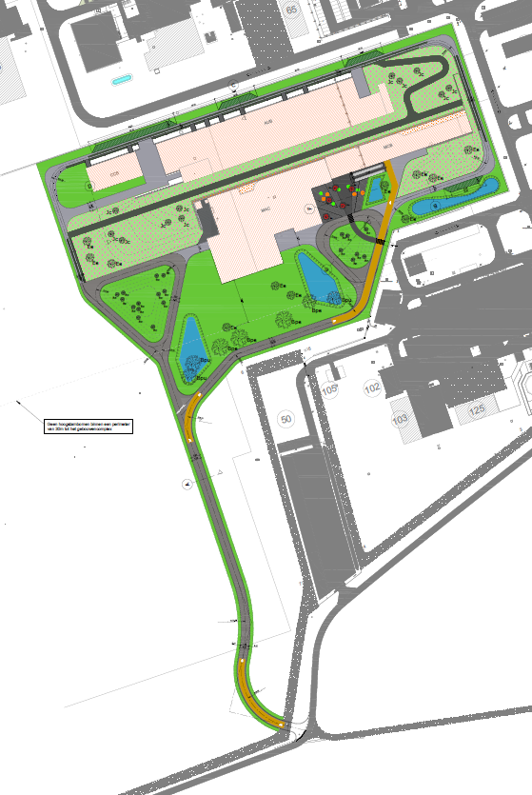
Masterplan - MINERVA
SCK CEN/84582975

Slide 44
Copyright © SCK CEN - 2020
All property rights and copyright are reserved.
This presentation contains data, information and formats for dedicated use only and may not be communicated, copied, reproduced, distributed or cited without the explicit written permission of SCK CEN.
If this explicit written permission has been obtained, please reference the author, followed by ‘by courtesy of SCK CEN’.
Any infringement to this rule is illegal and entitles to claim damages from the infringer, without prejudice to any other right in case of granting a patent or registration in the field of intellectual property.
SCK CEN
Belgian Nuclear Research Centre
Studiecentrum voor Kernenergie
Centre d'Etude de l'Energie Nucléaire
Foundation of Public Utility
Stichting van Openbaar Nut
Fondation d'Utilité Publique
Registered Office:
Avenue Herrmann-Debrouxlaan 40 - 1160 BRUSSELS - Belgium
Research Centres:
Boeretang 200 - 2400 MOL - Belgium
Chemin du Cyclotron 6 - 1348 Ottignies-Louvain-la-Neuve - Belgium
44

